Slide 2
^{DISCIPLINA MIEA} ²⁰¹⁹

Slide 3
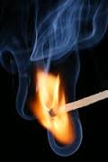
Technologies of combustion

Slide 4
Corpo docente
Carla Silva (Teóricas e práticas) /Theory and practice
camsilva@ciencias.ulisboa.pt

Slide 5
Thermochemistry
Maximum heat release, max Q_{out}: T_{out}=T_{in}
Maximum flame temperature, T_{ad}:
Hreag(T_{in})=Hprod (T_{ad})(constant pressure, e.g. Diesel engine, gas turbine, furnace)
Hreag(T_{in})=Hprod (T_{ad})-R(n_{prod}T_{ad}-n_{reag}T_{in}) (constant volume, e.g. gasoline engine)

Slide 6
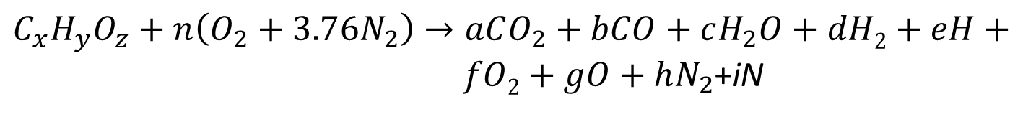
Thermochemistry
Ideal stoichiometric combustion
Real stoichiometric combustion
$$C_{x}H_{y}O_{z}+n\left(O_{2}+3.76N_{2}\right)→xCO_{2}+yH_{2}O+3.76nN_{2}$$
$C_{x}H_{y}O_{z}+n\left(O_{2}+3.76N_{2}\right)→aCO_{2}+bCO+cH_{2}O+dH2+eH+ fO2+gO+hN_{2}$+iN

Slide 7
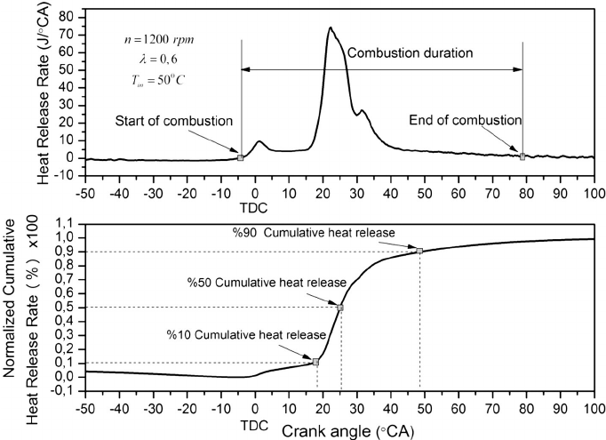
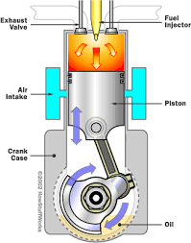
Emissions
∼ 80 ^{ο}CA
1000 rpm= 1000 revolutions per minute
1000*(360^{ο}CA )= 60 seconds
80 ^{ο}CA =0.2 ms
More rpm, less combustion time!!!

Slide 8
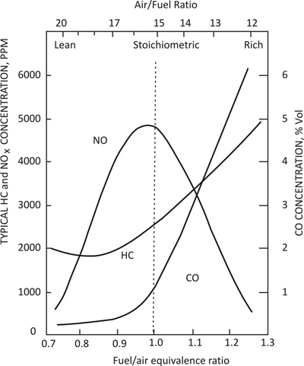
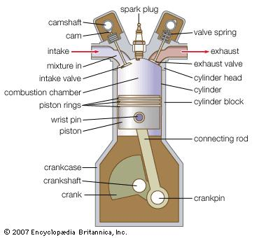
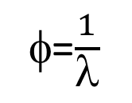
Emissions
φ=$\frac{1}{λ}$

Slide 9
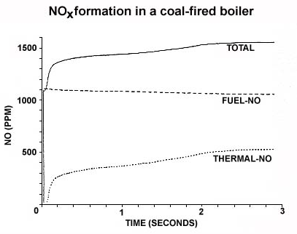
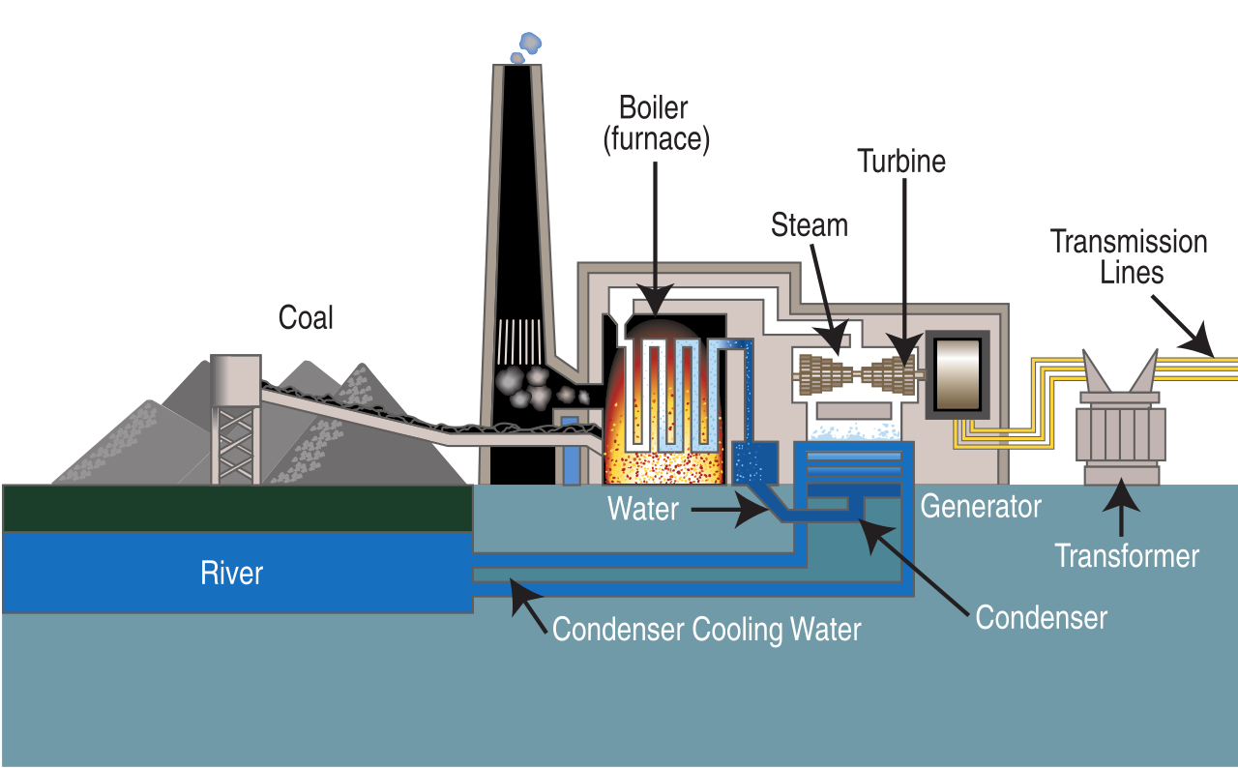
Emissions
ppm ☺ !!!!

Slide 10
Emissions
Adiabatic Flame Temperature
Constant pressure or volume
Adiabatic flame temperature
Poor, stoichiometric, rich (λ influence)
Exhaust gas recirculation
0 to 30%
Fuel
(gasoline, diesel, hydrogen, ethanol, biodiesel)
Water injection
Dissociation

Slide 11
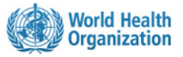
Emissions-Outdoor
low emission zones and the raising of air-quality target
particulate matter (PM)
ozone (O₃)
nitrogen dioxide (NO₂)
sulfur dioxide (SO₂)
Ambient (outdoor air pollution) in both cities and rural areas was estimated to cause 3 million premature deaths worldwide in 2012

Slide 12
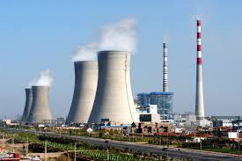
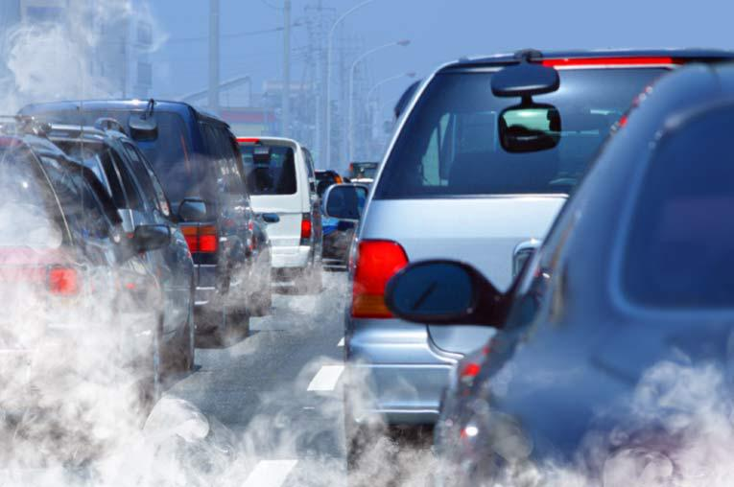
Emissions-Outdoor sources
Stationary combustion
(limits in mg/m3)
Mobile combustion
(limits in g/km)

Slide 13
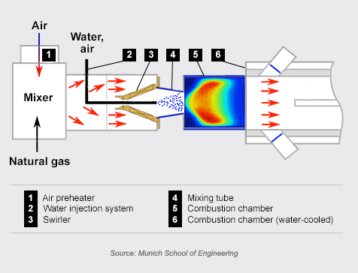
Emissions
low emission zones and the raising of air-quality target
CO₂
H₂O
N₂
CO
HC
NO
NO2
PM
CO₂
H₂O
N₂
Exhaust gas aftertreatment
Combustion alteration not enough!!!!!

Slide 14
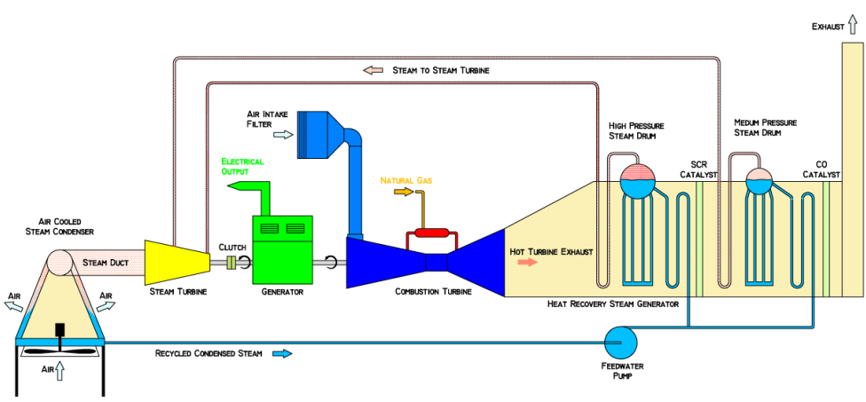
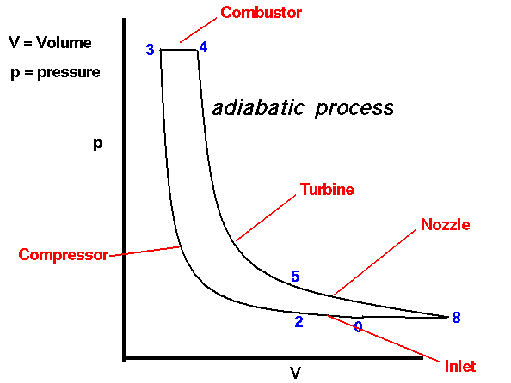
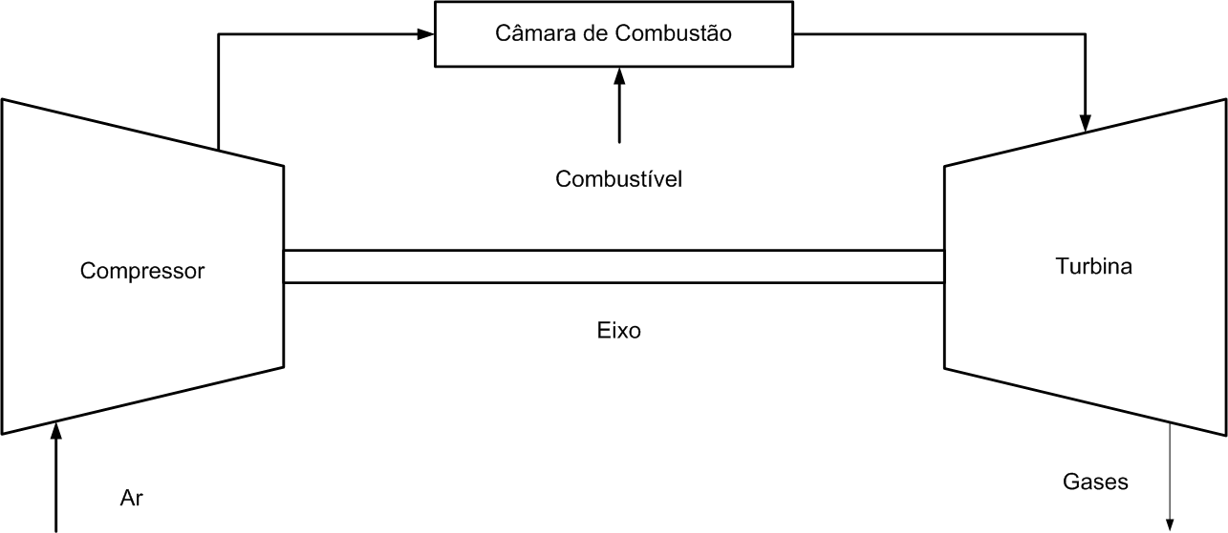
Emissions
Exhaust gas aftertreatment

Slide 15
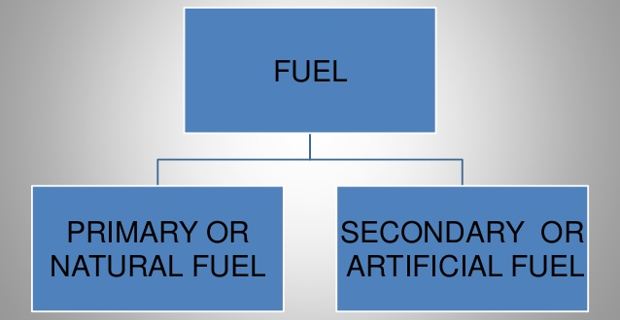
Fuel types
SOLID
LIQUID
GAS

Slide 16
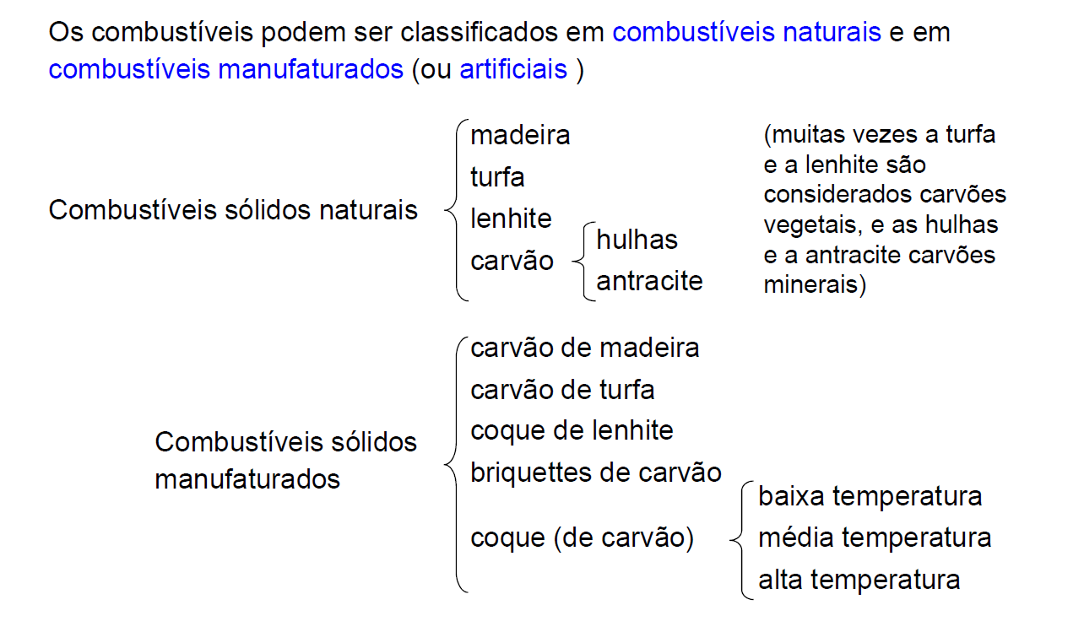
Fuel types

Slide 17
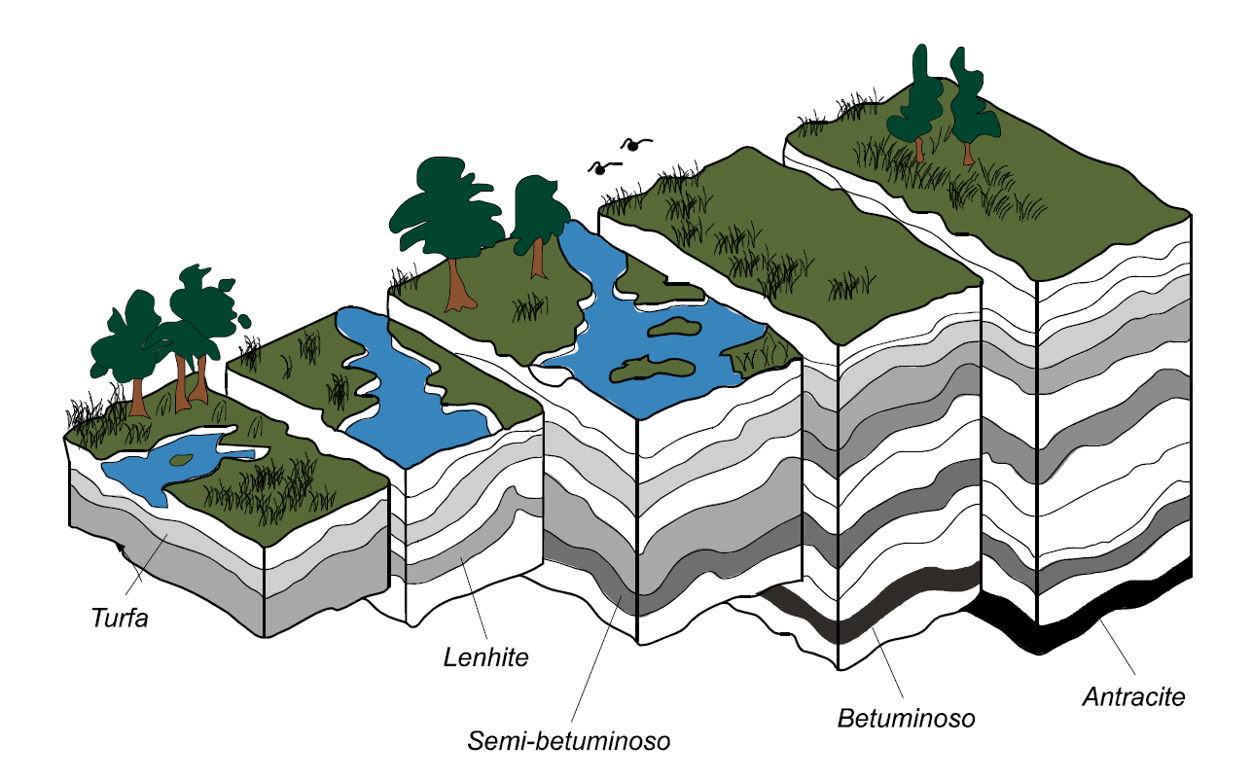
Fuel types
Time, pressure, heat
Peat
Lignite
Anthracite
Sub-bituminous
Bituminous

Slide 18
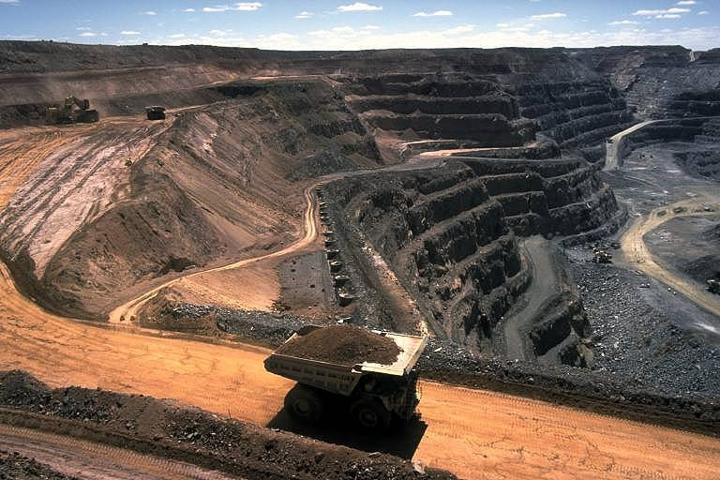
Fuel types
Time, pressure, heat
Peat
Lignite
Anthracite
Sub-bituminous
Bituminous

Slide 19
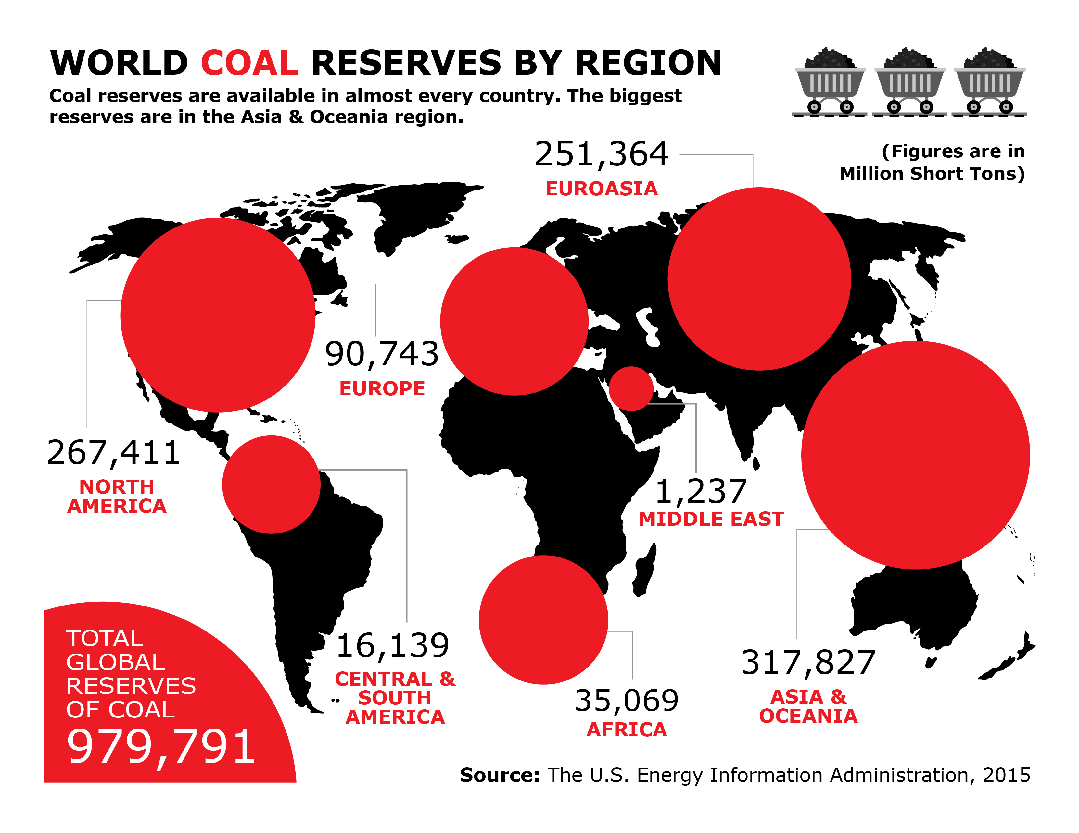
Fuel types
1 short ton
907.18474 kg

Slide 20
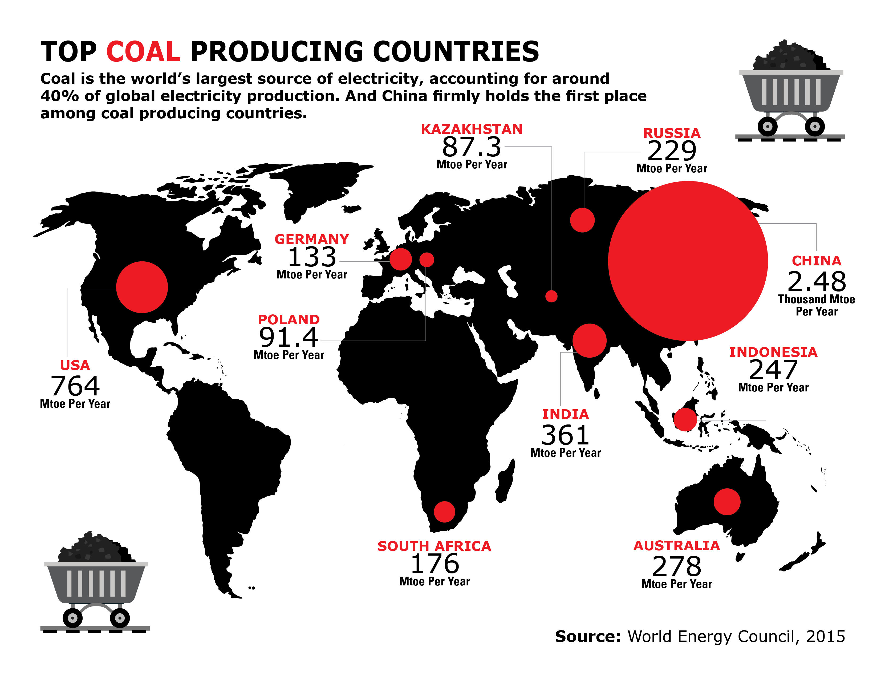
Fuel types

Slide 21
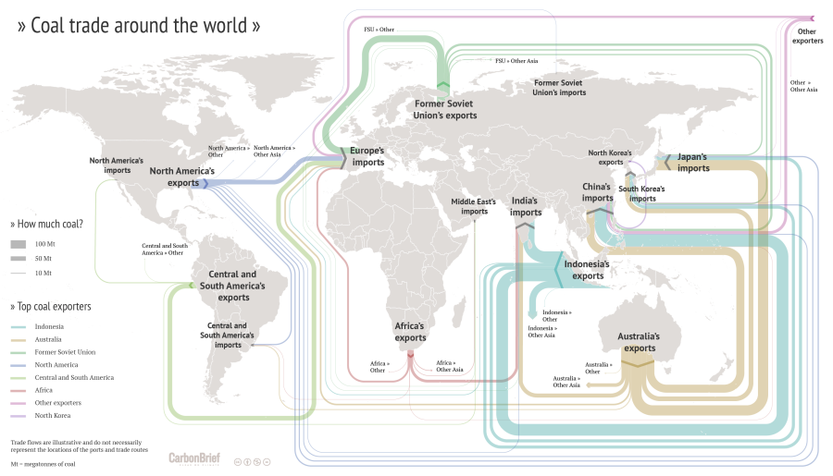
Problems with ash

Slide 22
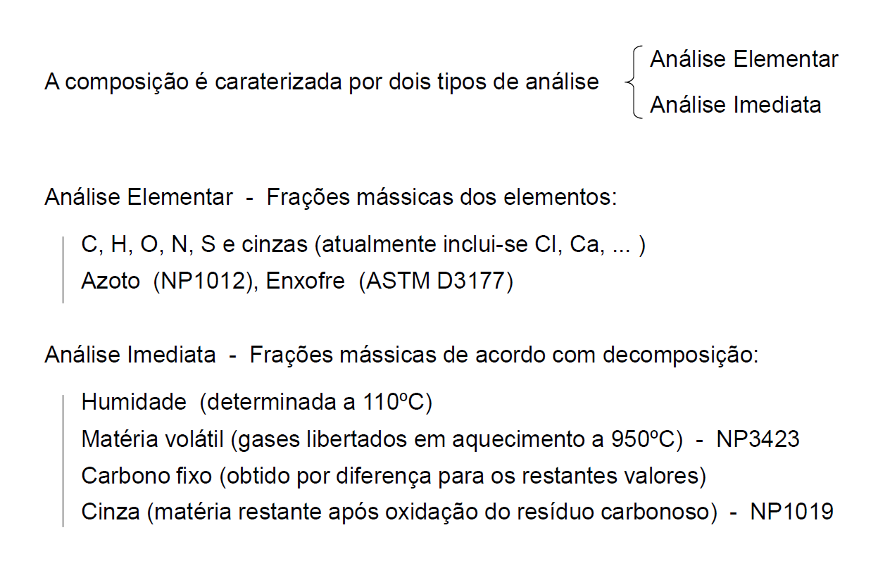
Fuel types

Slide 23
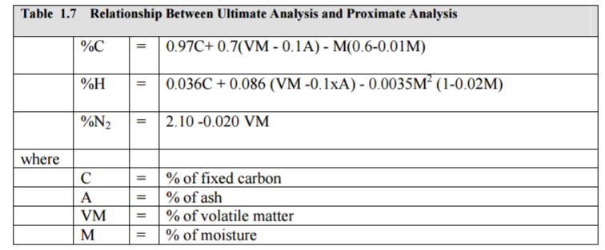
Fuel types

Slide 24
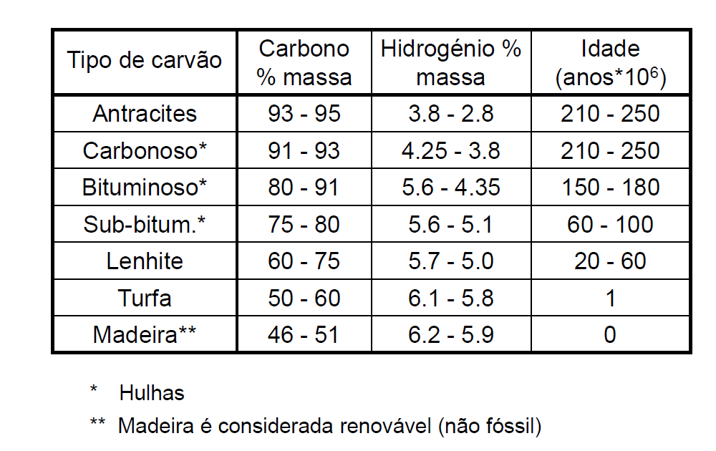
Fuel types

Slide 25
Fuel types
Correlations for Higher Heating Value (HHV or PCS)
PCS ~ 33,8 xC + 144,3 (xH - xO/8) + 9,4 xS (Dulong)
PCS ~ 34,1 xC + 132,3 [xH - (xO + xN)/11] + 6,8 xS – 1,5 xAs
(Mason and Gandhi, 1983)
in MJ⋅kg-1 and dry basis. Last includes ash effects xAsh

Slide 26
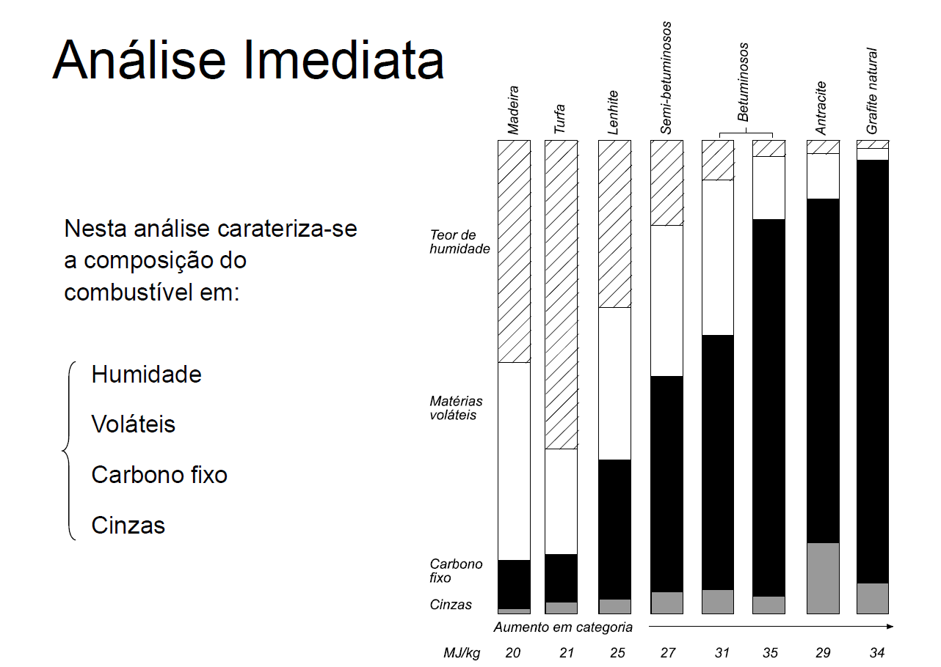
Fuel types

Slide 27
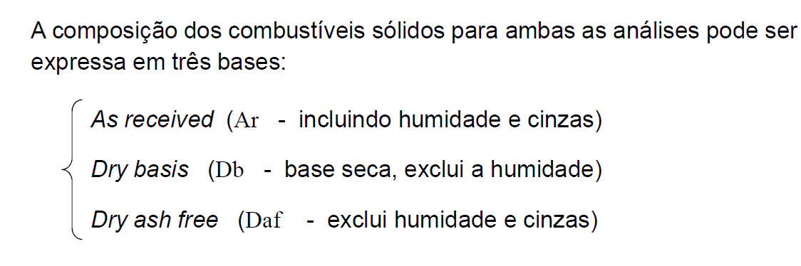
Fuel types

Slide 28
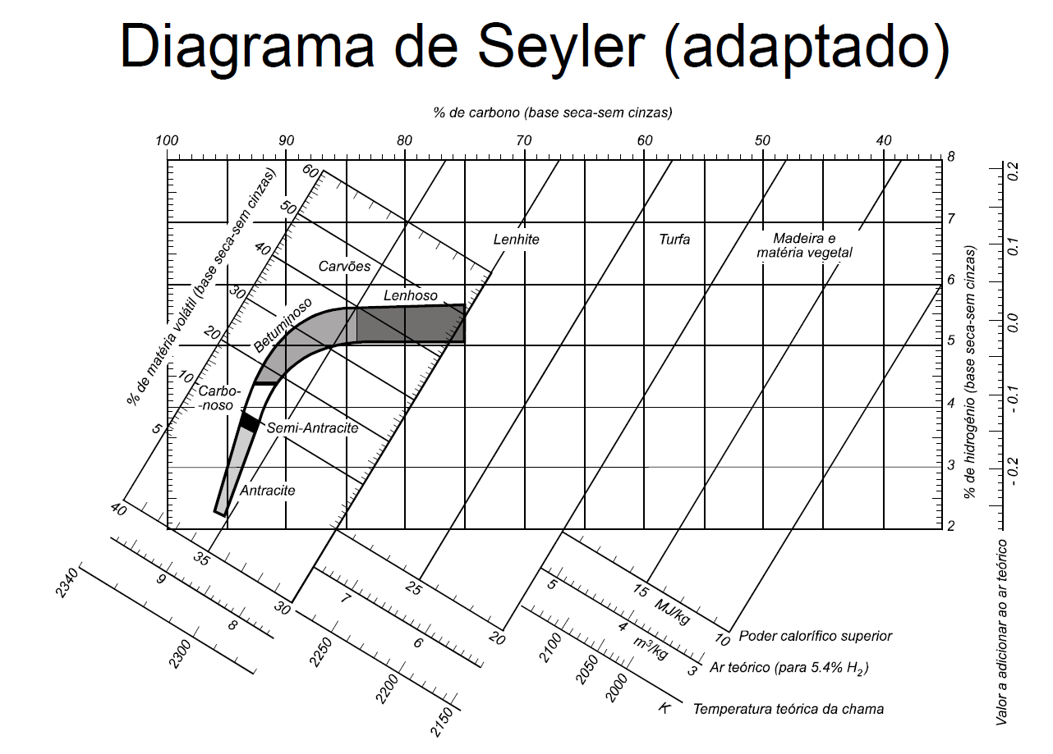
Fuel types

Slide 29
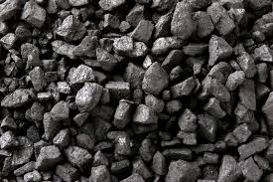
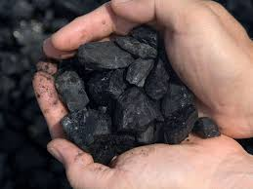
Fuel types
Even with complete combustion the minimum particle emissions are limited by the ash content inicially in the fuel
Ash is the general term used to describe the inorganic matter in a fuel, e.g. Fe, Ca, K, Si, etc
There is an absence of carbon in its composition
It is of a non-biologic origin

Slide 30
Fuel types
P#13 Consider this coal. Classify the coal according to the Seyler diagram. Identify lower heating value and adiabatic temperature.

Slide 31
Problems with ash
Slagging
(molten ash)
Ash deposit
Fouling
volatile inorganic elements in the coal during combustion on heat exchangers
(ash deposit on heat exchangers)

Slide 32
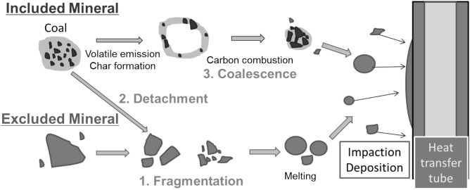
Fuel types
Melting point

Slide 33
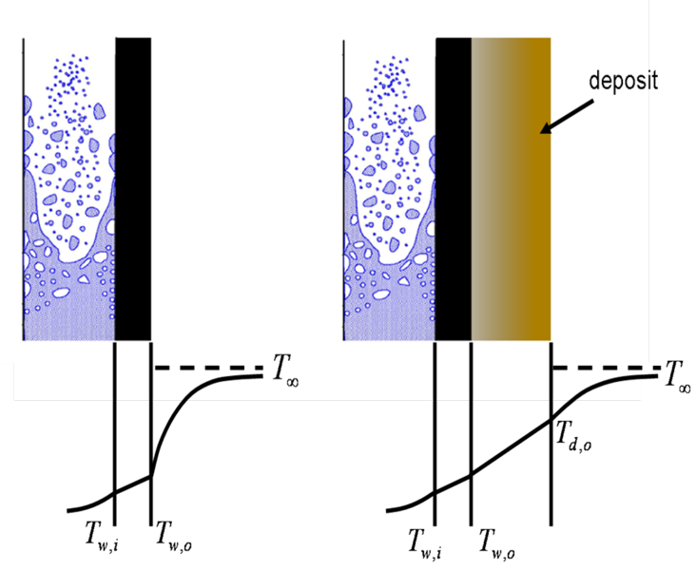
Problems with ash
Increase of combustion temperature!! Low heat loss to water!!!
Slagging (molten ash)
Fe-iron Melting temperature: 1538 ^{ο}C (1811 K)
Magnesium: 650 ^{ο}C (923 K)
SiO2 (silica): 1710 ^{ο}C (1983 K)
Al₂O₃=2072 ^{ο}C (2345 K)

Slide 34
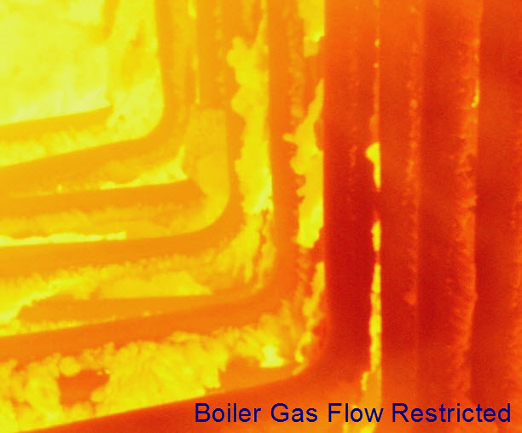
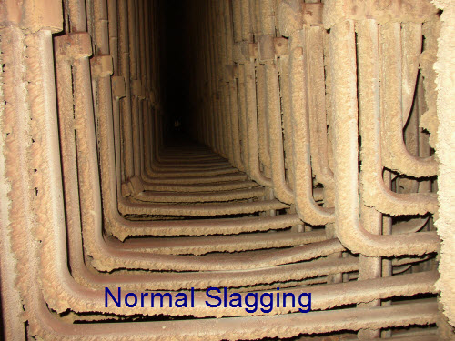
Problems with ash

Slide 35
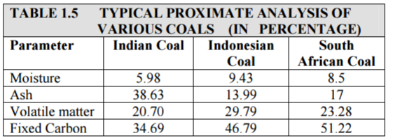
Problems with ash

Slide 36
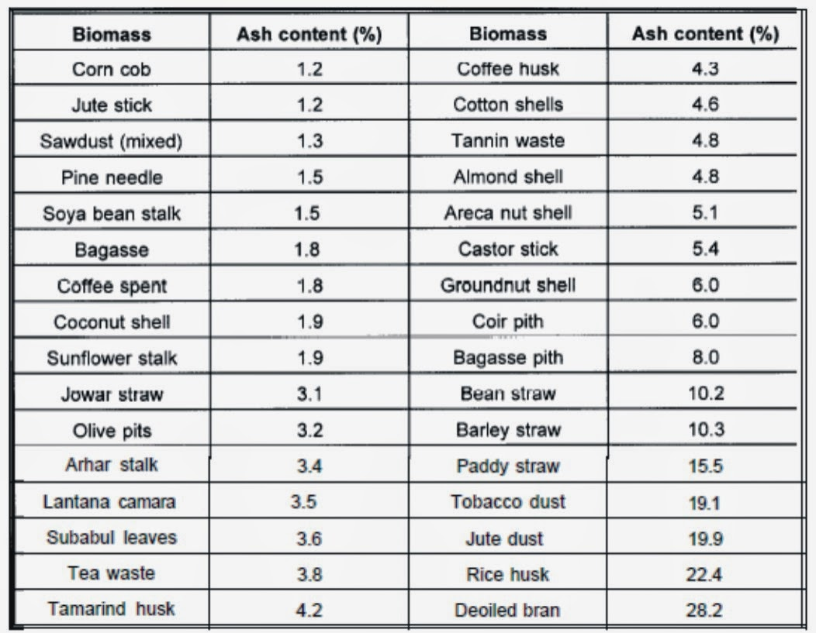
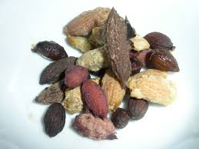
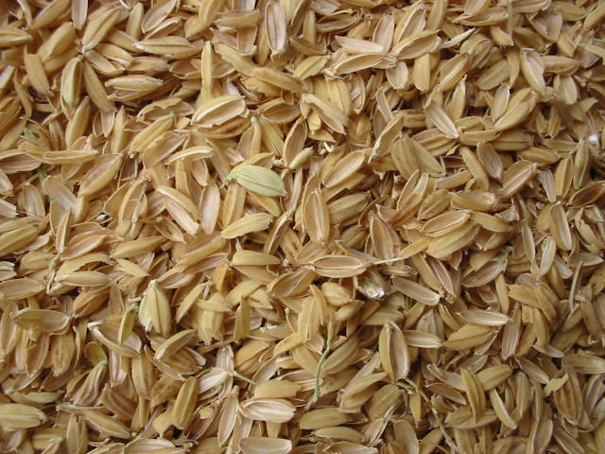
Problems with ash

Slide 37
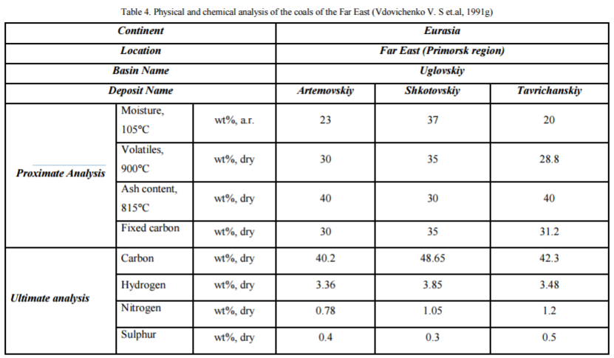
Problems with ash

Slide 38
Problems with ash
Coal low moisture; low ash
the better!!

Slide 39
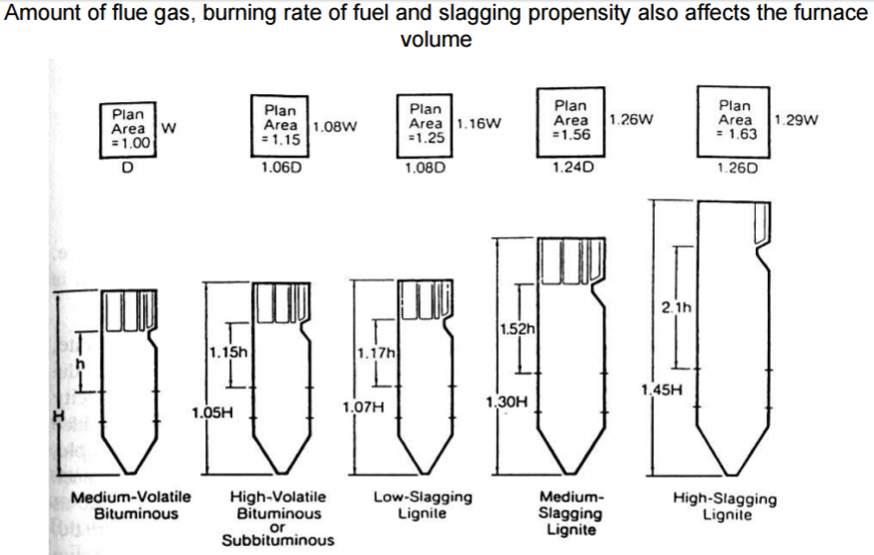
Problems with ash

Slide 40
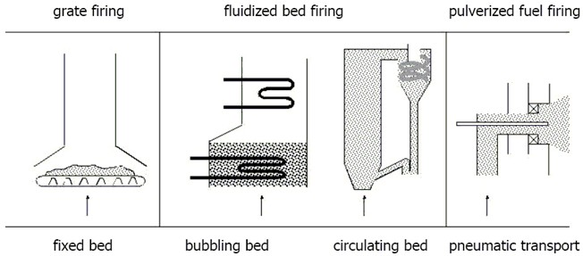
Problems with ash

Slide 41
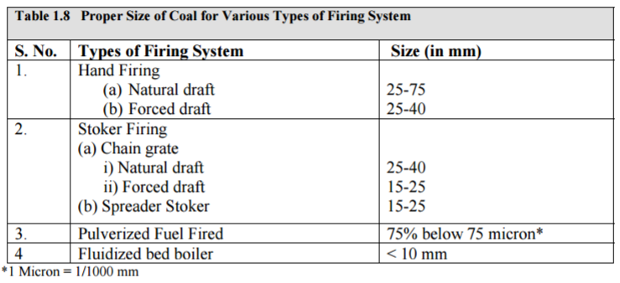
Fuel types

Slide 42
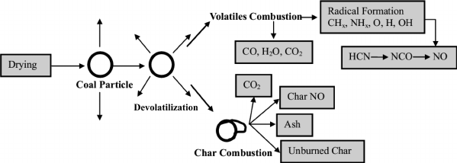
Combustion in solids
Three stages of mass loss:
Drying (removal of water):endothermic;
Devolatilization: vaporization of volatile organic compounds, gas-phase diffusion flames;
Char combustion: heterogeneous (solid phase fuel, gas phase oxidizer) combustion of fixed carbon.
Pyrolysis starts
250-300^{ο}C
100^{ο}C
900^{ο}C
Fixed carbon combustion starts
Coal particle weight decreases

Slide 43
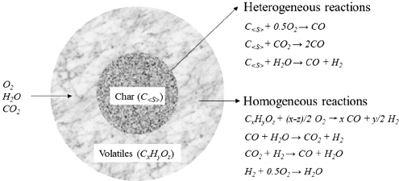
Coal combustion
homogeneous
combustion
volatiles
CO₂, H₂O, …
coal particle
p-coal, d=30-70μm
heterogeneous
combustion
char
CO₂, H₂O, …
devolatilization
t_{devolatile}=1-5ms
t_{volatiles}=50-100ms
t_{char}=1-2sec
t

Slide 44
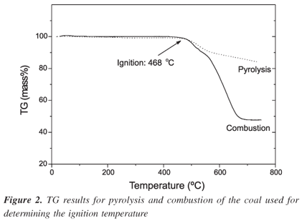
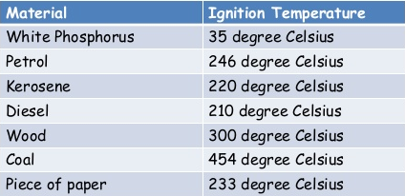

Combustion in solids
Thermogravimetric analysis or thermal gravimetric analysis (TGA) is a method of thermal analysis in which the mass of a sample is measured over time as the temperature changes.

Slide 45
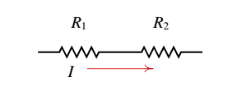
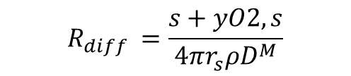
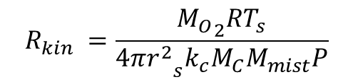

Combustion in solids
COMBUSTION MODEL – 1 layer
10 μm
$$R_{kin }=\frac{{M_{O}}_{2}RT_{s}}{4π{r_{}^{2}}_{s}^{}k_{c}M_{C}M_{mist}P}$$
$$R_{diff }=\frac{s+yO2,s}{4π{r_{s}^{}ρD}_{}^{M}}$$
100 μm
Kinetic mechanism
Diffusion mechanism
1000 μm
s/kg
ΔV= ΔyO₂
$$\dot{m_{\text{C}}}$$
kg/s
y = mass fraction

Slide 46


Combustion in solids
COMBUSTION MODEL – 1 layer
R_{kin}
yO₂=yO₂,s
R_{diff}
s/kg
yO₂=0
yO₂= ∞
$$\dot{m_{\text{C}}}$$
kg/s
y = mass fraction

Slide 47


Combustion in solids
A.exp (-E_{A}/R.Ts)
$$R_{kin }=\frac{s}{4π{r_{}^{2}}_{s}^{}{ρk}_{c}}$$
Kinetic rate ∼ 3*10⁵exp (-17966/Ts) m/s
Mixture density ρ = P/(R/M*Ts)
Mixture molar mass∼ 29 kg/kmol
s${{=M}_{O}}_{2}/MC$
$$R_{diff }=\frac{s+yO2,s}{4π{r_{s}^{}ρD}_{}^{M}}$$
Diffusion rate ∼ 1.2*10⁻⁴ m²/s
0.5 x Particle Diameter

Slide 48

Combustion in solids
Time for burning = $D2$/K_{B}
K_{B}=$\frac{8ρD^{M}}{ρ_{C}}ln⁡(1+\frac{yO2,∞ }{s}$)
Residence time in the boiler is typically 2-5 seconds

Slide 49

Combustion in solids
Less coal particle size more PM emissions
Coal type | Coal particle size, μm | Ultimate analysis, wt.%, daf
 |  | C | H | N | S+Oª
YZLS | 125–250 | 81.89 | 5.59 | 2.31 | 10.20
 | 63–125 | 80.13 | 5.30 | 2.08 | 12.49
 | <63 | 79.45 | 5.10 | 2.07 | 13.37
Zhangji | 125–250 | 81.46 | 5.97 | 1.88 | 10.69
 | 63–125 | 80.15 | 5.64 | 1.68 | 12.53
 | <63 | 79.58 | 5.50 | 1.73 | 13.19
Wangfg | 125–250 | 85.60 | 5.38 | 2.13 | 6.89
 | 63–125 | 87.96 | 6.06 | 2.19 | 3.79
 | <63 | 88.52 | 5.48 | 2.22 | 3.79
http://www.sciencedirect.com/science/article/pii/S0378382003003060

Slide 50

Combustion in solids
Control of PM10 and PM2.5

Slide 51


Combustion in solids
Scrubber “Spray tower”
“Cyclonic Spray”

Slide 52
Combustion in solids
Combustion of coal main pollutants:
NOx and PM!!!

Slide 53
Combustion in solids
P#16 Using a one layer coal combustion model estimate the combustion rate of the coal particles. And the time of burning.
Ts~ 1500 K
10 μm
Combustion rate kg/s ????
In what time ??????
Estimate the minimum residence time in the boiler for combustion of all coal particles.
100 μm
1000 μm
ρ_{C}~ 1900 kg/m³

Slide 54

Emissions
Review#1 A mixture of methane gas and air at 25^{ο}C and 1 atm is burned in a water heater at 100% theoretical air. The mass flow rate of methane is 1.15 kg/h. The exhaust gas temperature was measured to be 500 ^{ο} C and approximately 1 atm and is subjected to exhaust aftertreatment. The volumetric flow rate of cold water (at 22 ^{ο} C) to the heater is 4 L/min.
Determine the combustion efficiency.
Calculate the temperature of the hot water if the heat exchanger were to have an efficiency of 1.0, i.e., perfect heat transfer.
Consider the following concentrations of emissions at the combustion products: 5000 ppm NO. Estimate the NO exhaust gas emissions in g/h.

Slide 55
Emissions
Review#2 (exercicio 12.4 livro Português) Uma caldeira de uma central termoelétrica é alimentada com um fuel-óleo residual que apresenta a seguinte composição mássica elementar indicada na tabela. Considerando combustão completa com 25% de excesso de ar,
Estime a relação (A/F)st.
Estime a concentração mássica de SO₂ nos produtos de combustão.
Compare com o limite seco a 3% de O₂ de 200 mg/Nm3.
Pode estimar a concentração de partículas no escape? Como?
C | 86.4%
H | 9.8%
N | 0.35%
S | 1.13%
O | 2.28%
Cinzas/Ash | 0.04%

Slide 56
Emissions
Review#3 Ultimate analysis (dry basis wt%)
C | H | O
52.30 | 7.00 | 40.10
Proximate analysis |  |  |  | ar | dry daf
 |  | Moisture content | wt% | 3.87
 |  | Volatile matter | wt% | 76.90 | 80.00 | 80.48
 |  | Ash content | wt% | 0.58 | 0.60
 |  | Fixed carbon | wt% | 18.65 | 19.40 | 19.52
Determine the ar and daf ultimate analysis.
What is the fuel according to the Seyler diagram?
What would be the (A/F)s in mass and molar basis?
What will be the first thing that is burned? Estimate its chemical formula.
What would be the colour of the flame in a forest fire situation? Justify.

Slide 57

Assignement #2
Deliver: 21 May 2019
Excel+pdf
5 val

Slide 58
^{Obrigado}

